Slide 1
Phone Number Validation API
Project Level 1

Slide 2

Project Owner:
Firew
Presented by:
Group B Team members

Slide 3
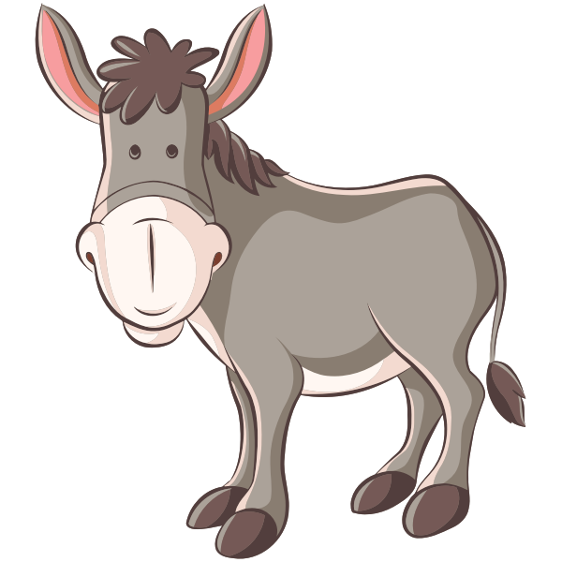
Creating a service that verifies a phone number of a customer. This API gets a phone
number from a customer as a query param and it should call a third party service to verify the number of the customer.
Objective of the project

Slide 4
Requirements:
1. Follow Mulesoft API development naming convention
2. Write a RAML file
3. Code has to be checked in your team repo
4. There should be appropriate logging
5. During implementation, use validator component so that you
can save money from unnecessary 3rd party API call.
6. Password, API key, etc should be encrypted. This has to be
achieved using secure properties. Refer:
https://docs.mulesoft.com/mule-runtime/4.2/secure-
configuration-properties
7. Mule flows needs to handle errors
8. The API should be secured with client id and secret
9. Reconnection strategy needs to be defined
10. All connectors needs to be configured and externalized
11. Secure keys need to be masked when exposed as
runtime property
12. There should be Dev, QA and Prod env’t
13. Munit coverage should be >=75%

Slide 5
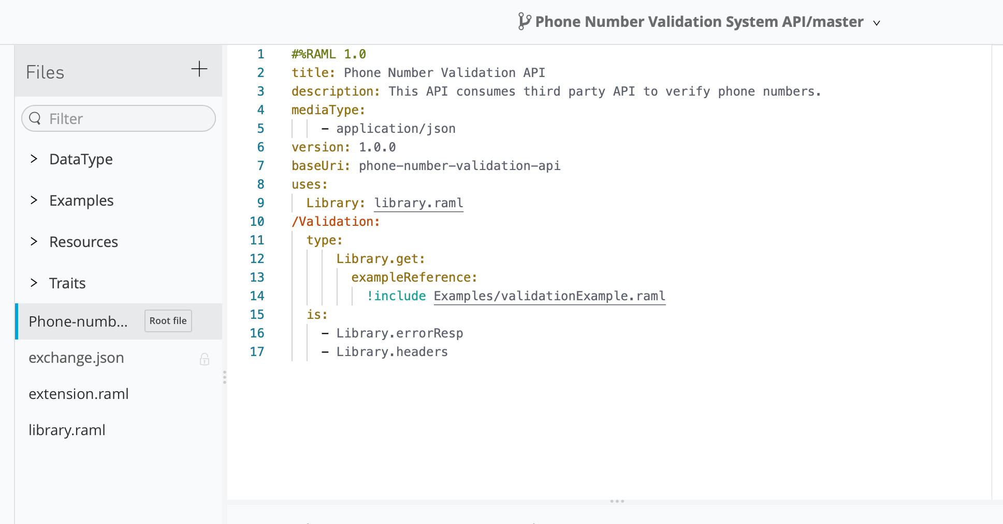
RAML:
The RAML file has only one endpoint named /Validation. We also included a queryparam (number) as per requirement.

Slide 6
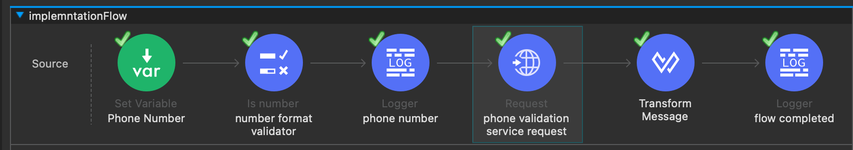
Logging System: Multiple Loggers were put strategically throughout the flow to inform the progress of the flow.

Slide 7
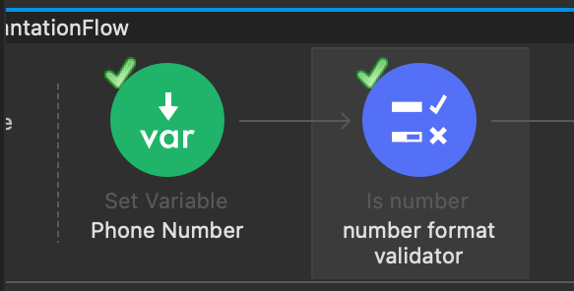
Validator components: Is number validator component was used throughout the flow so that client
can save money from unnecessary 3rd party API call.

Slide 8
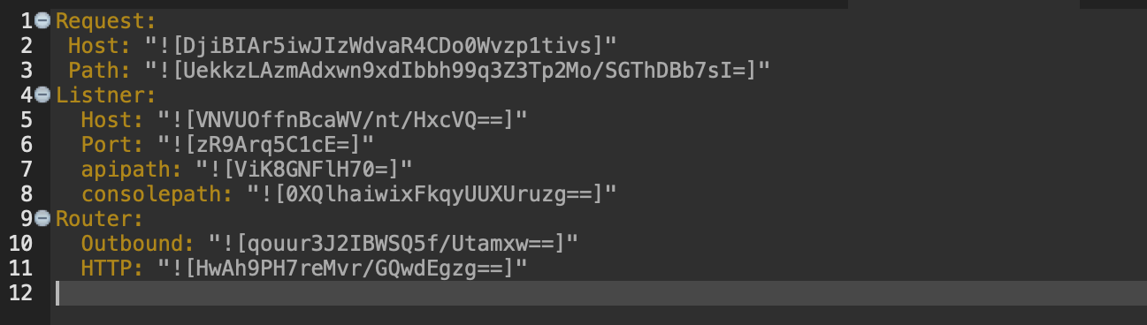
Secure properties: sensitive informations such as Passwords, API keys, were encrypted.

Slide 9
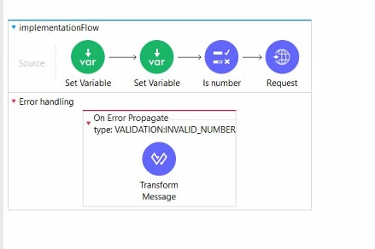
Error Handlers:

Slide 10
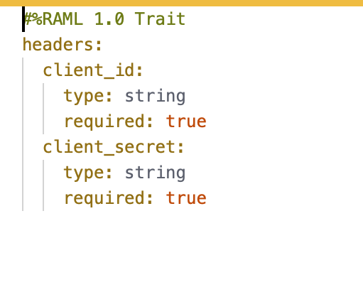
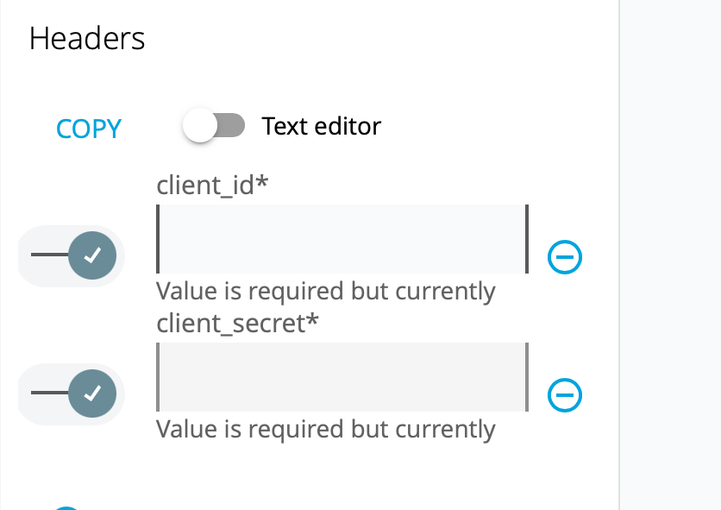
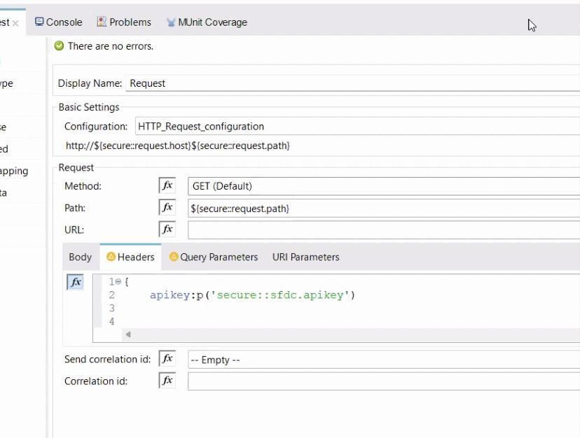
Secure API: The API is secured with client id and secret as per requirement

Slide 11
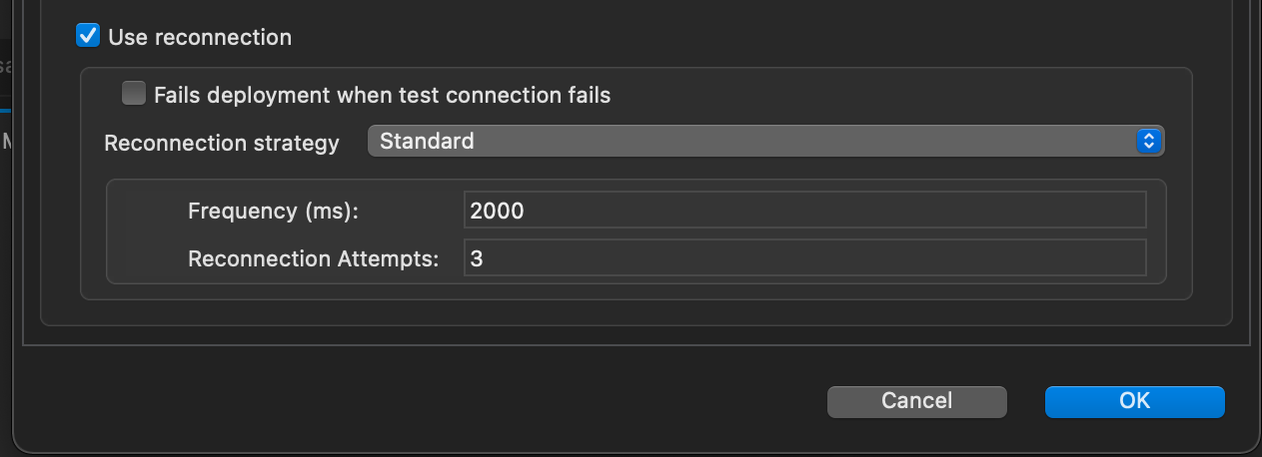
Reconnection strategy:

Slide 12
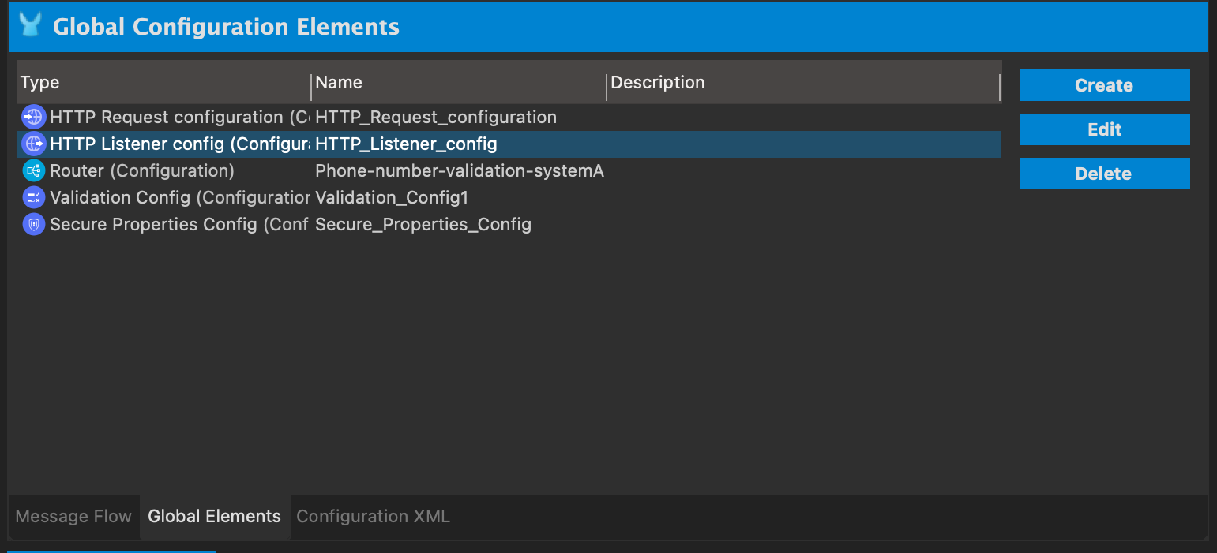
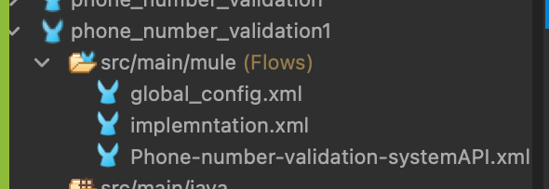
File externalization:

Slide 13
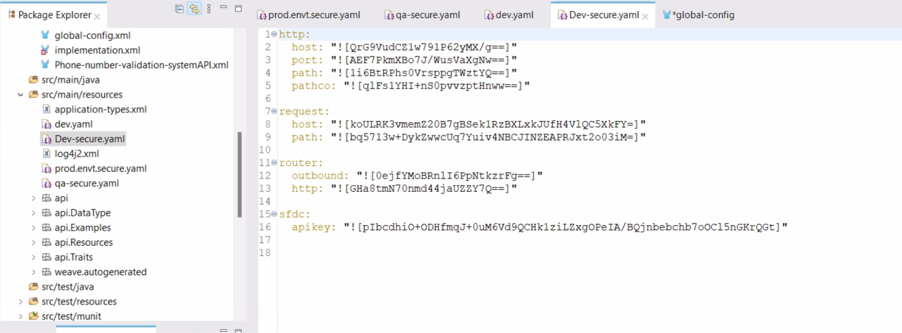
Environments: we created three environments
DEV, QA, PROD

Slide 14
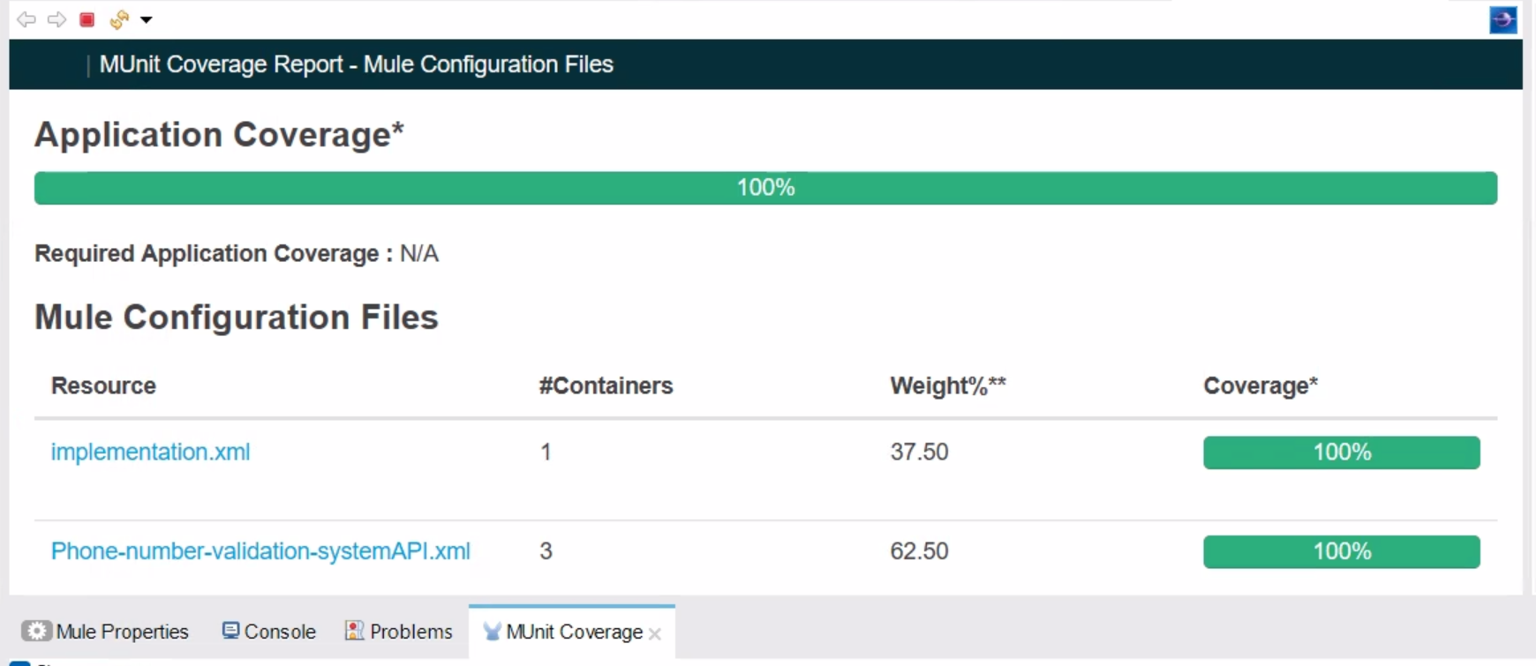
Munit coverage: was 100%

Slide 15

Git-repo: https://github.com/Craft-groupB/Craft-phone-validation-API.git

Slide 16
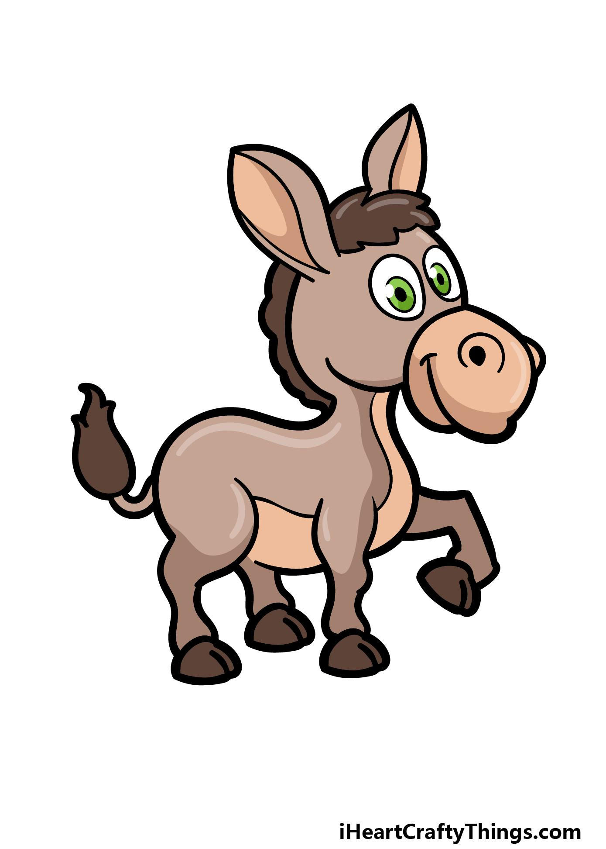
Questions???

